Slide 1
Broadcast Technology UG1
1: Transmission Media
Jerry Foss
jeremy.foss@bcu.ac.uk

Slide 2
The Context …

Slide 3

Information Transmission, Signal Encoding
Information
Information
Source Information
coded data in as small space as possible (compressed, etc)
Source Coding
Source Decoding
Channel Coding
Channel Decoding
Channel coding
appropriate error protection method
... depends on channel characteristics
modulation on to carrier
bit errors
Modulation
Demodulation
NOISE
signal received – reverse processes
Transmission Link
Crosstalk
Interference
Phase Distortion
Crosstalk
Attenuation
jitter
NOISE
NOISE
transmission is subject to noise interference
aim – to approach the Shannon Limit
jeremy.foss@bcu.ac.uk

Slide 4
DVB Transmission Playout System
(Based on DVB-T, but –C, -S and –H are similar)
Video Packets
Audio Packets
COMPRESSION
TS Mux
Mux adaptation, scrambling
Error Correction
Block Code
Interleaving
(against long errors)
FEC
Convolutional
coding
Data Packets
FEC – Outer …….
FEC – Inner
Interleaving
(against burst errors)
Mapper
(IQ symbols)
Frame adaptation
symbols
Pilot, TPS signals
OFDM
Modulation
Guard interval insertion
DAC for Tx
QPSK, QAM, etc
Blocks (1512 – 6048 sy/block)
of symbols →
frames (68 blocks)
(4frames =superframe)
Transmission parameters
carriers, 2k – 32k (for T2
channel b/w =
1.7 to 10MHz
includes cyclic prefix
Antenna,
Cable,
Sat uplink

Slide 5
Back to Basics

Slide 6
Transmission
Media

Slide 7
Transmission Media
Types of Transmission Media
Multiplexing - FDM, TDM, Statistical
* introduction only – will be covered in depth later on
Cables
Twisted Pair
Coaxial
Fibre Optic
Wave Division Multiplexing
Radio
Spectrum
Transmitter
EM Wave, Radio Waves
Propagation through lower and upper atmosphere
Broadcast Transmitter Technologies (valves)

Slide 8
Types of Transmission Media
“Guided”: The waves are guided along a physical path
“Unguided”: The medium transmits the waves but does not guide them
Types of Transmission Connection
Direct Link:
The signal is propagated directly from transmitter to receiver (perhaps through amplifiers/repeaters)
Point-to-Point:
A guided medium that provides a direct link between two and only two devices
Multipoint:
A guided medium that is shared by more than two devices
ref – Prof. David Bernstein, James Madison University

Slide 9
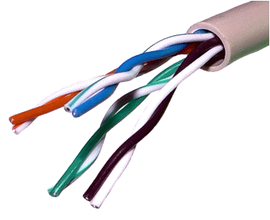
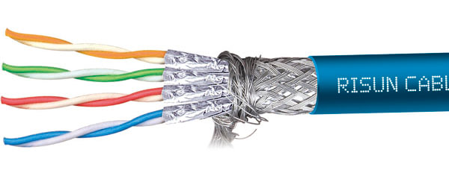
Twisted Pair Cable
Two insulated copper wires that are twisted together (which results in cancellation of induced interference; cancellation of radiated interference, hence reduces radiation)
The individual pairs can be shielded (STP) or unshielded (UTP)
The cable can also be shielded (S/STP)
Categories (CAT ...)
1 - primarily for voice
2 - 4Mbps
3 - 16MHz bandwidth; 10Mb/s
4 - 20MHz bandwidth; 16Mb/s
5 - 100MHz bandwidth; 100Mb/s (4 pairs/cable)
- 400MHz bandwidth; 1Gb/s (4 pairs/cable)
- 600MHz bandwidth (1GHz for Augmented); 10Gb/s
- 1.2GHz bandwidth
Common Uses:
Voice Telephony, various Digital Subscriber Line (xDSL), LANs
CAT 7 – Screen Shielded Twisted Pair (SSTP)

Slide 10
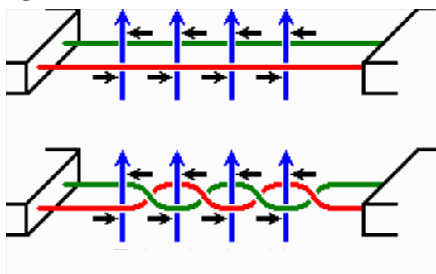
Twisted Pair Cable
Noise generated by magnetic fields from the environment.
noise current is the result of that magnetic field
straight cable - all noise current flows same direction
twisted cable – in alternate twists noise current is the opposite from the current in other twists
Untwisted cable
Twisted cable
Magnetic field
Induced noise current

Slide 11
Twisted Pair Cable
Advantages:
High availability
Low installation cost
Disadvantages:
Usable frequency spectrum is small
Limited data rates
Limited range
High suceptibility to electromagnetic and radio frequency interference
ref – Prof. David Bernstein, James Madison University

Slide 12
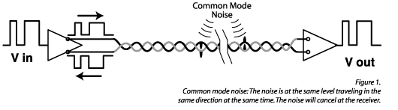
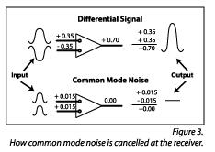
Twisted Pair Cable
In balanced pair operation -
Differential mode transmission -
differential signals; receiver detects the difference between the two
noise signals tend to couple to both wires equally
∴ noise produces a common signal in each conductor
- which is cancelled at the receiver
(not effective when the noise source is close to the signal wires; closer wire will couple with the noise more strongly)
Twist rate
more twists the better (usually)
http://www.extron.com/company/article.aspx?id=utptechnology

Slide 13
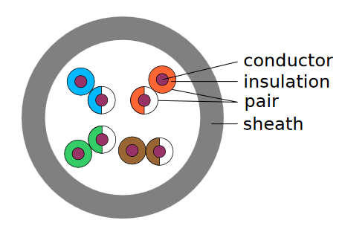
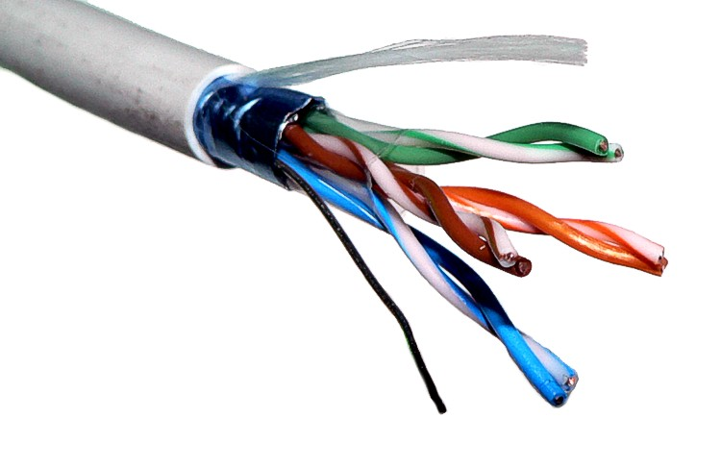
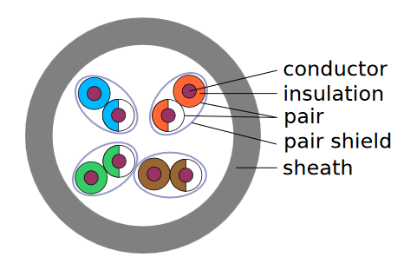
Twisted Pair Cable
UTP: Unshielded twisted pair
UTP
STP: Shielded twisted pair
Twist rate
more twists the better (usually)
STP

Slide 14
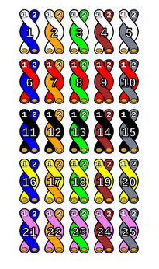
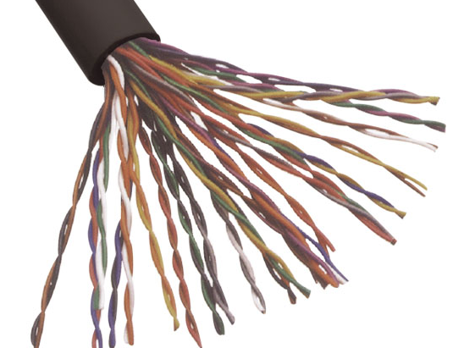
Twisted Pair Cable
Telecommunication cables pairs in the same cable adjacent for many miles
... one pair can induce crosstalk in another
each half twist the wire nearest to the noise-source is exchanged
also reduces electromagnetic radiation from the cable

Slide 15
IEEE Cable Standards for Ethernet on Twisted Pair
10BASE-T
transmission at 10 Mb/s on unshielded twisted-pair cabling
defines various aspects of running Ethernet on this cabling.
100BASE-T
transmission at 100 Mb/s on unshielded twisted-pair cabling
defines various aspects of running baseband Ethernet on this cabling
1000BASE-T (gigabit Ethernet) transmission at 1000 Mb/s on unshielded twisted-pair cabling
defines various aspects of running baseband Ethernet on this cabling

Slide 16
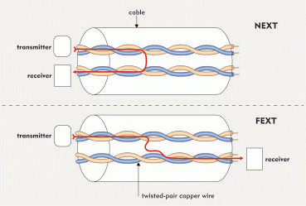
Signal Issues on Twisted Pairs at High Frequencies
Frequency dependent attenuation and dispersion
… Intersymbol Interference (ISI)
Coupling between wires in same and adjacent binders
… crosstalk - near-end cross-talk = NEXT
- far-end cross-talk = FEXT
Bridged taps and gauge transitions
… reflections : pulse distortion (ISI)
Impulsive noise : high bursts of short duration (10 ms - 1 ms)
Impedance mismatch between hybrid and line impedance
… reflections (echo)
RFI interference: AM broadcast & amateur radio
… ingress & egress
All these require a highly adaptive transceiver (at each end)

Slide 17
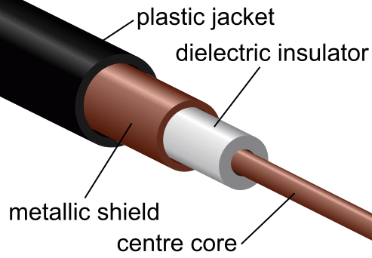
Coaxial Cable
Common Types:
RG-6 - 1.00mm core, 75 Ω
RG-59 - 0.81mm core, 75 Ω
RG-58 - 0.90mm core, 50 Ω
RG-8 - 2.17mm core, 50 Ω
Common Uses:
Applications for RF signals
Cable TV (Old: RG-59; New: RG-6)
Ethernet (RG-58: 10Base2; RG-8: 10Base5)
connecting radio transmitter feeds
A (thick) copper wire surrounded by an insulator and an outer conductor
Advantages:
High capacity (370-1000 times more than twisted pair)
Low susceptibility to noise and crosstalk (because of shielding)
Disadvantages:
Noise on the return path
High installation cost

Slide 18
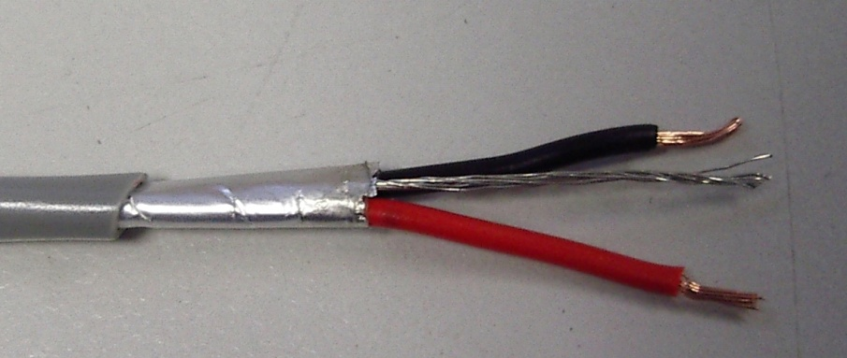
Coaxial Cable
dimensions of the cable are controlled to give a precise, constant conductor spacing
needed to function efficiently as a radio frequency transmission line
electric and magnetic fields are confined to the dielectric with little leakage outside the shield
electric and magnetic fields outside the cable are largely kept from causing interference to signals inside the cable
design of cable to control the electrical transmission properties ...
compare to standard shielded cable

Slide 19
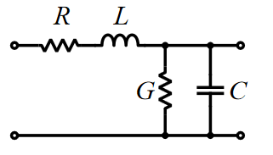
Coaxial Cable
All cables have electrical properties - they are not just short-circuits between equipment
Electrical properties of any cable pair:
R: resistance along the cable
L: signals cause inductance along the length of the cable
G: conductance - a certain amount of leakage, similar to a high resistance between the conductors
C: capacitance between the two conductors
Coax cable is designed to control these parameters

Slide 20
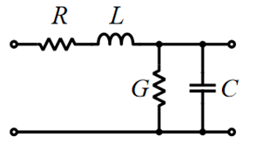
Coaxial Cable
All cables have electrical properties - they are not just short-circuits between equipment
All cables are effectively a (mathematically) complex circuit of distributed impedance sections

Slide 21
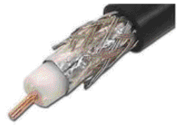
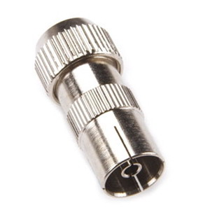
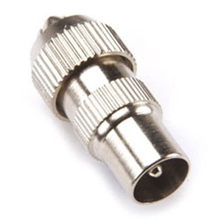
Coaxial Cable
Double shielded coax
Coax female socket Coax male plug

Slide 22
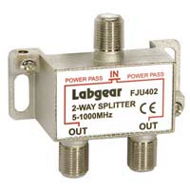
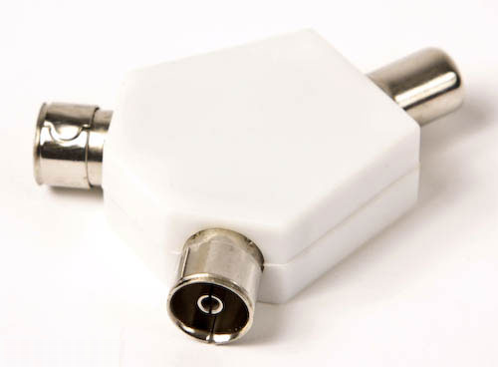
Coaxial Cable
Splitting signals
simple 2-into-1 can cause impedance imbalance
splitters should normally terminate each cable and combine in an impedance-balanced circuit, especially at high RF feeds

Slide 23
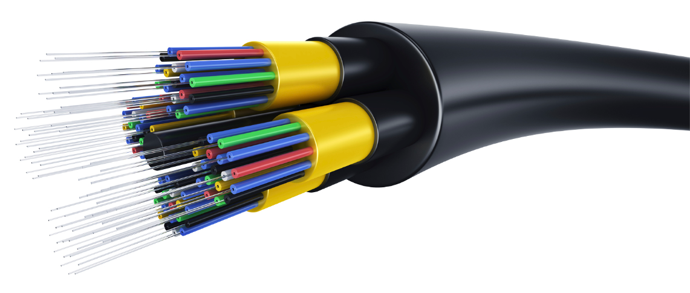
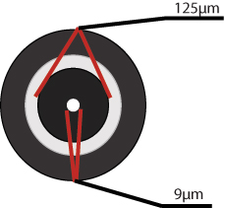
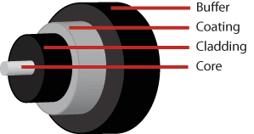
Fibre Optic Cable
A thin glass core surrounded by cladding that reflects light into the core
surrounded by a protective plastic buffer/jacket
Common Uses:
Cable TV
Voice Telephony
Ethernet
9 – 62.5mμ

Slide 24
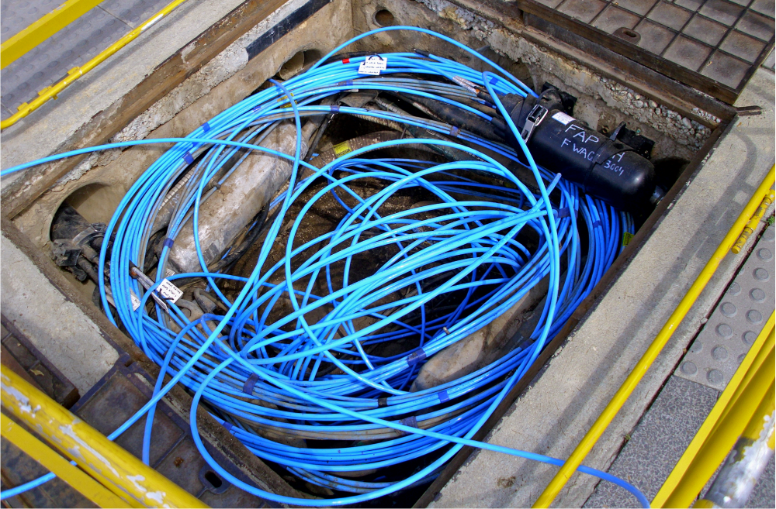
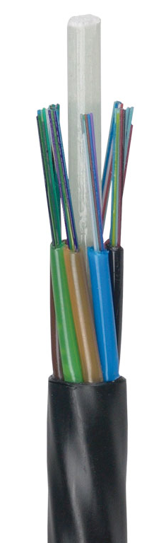
Fibre Optic Cable
Fibre for local distribution
MicroCore Blown Fibre Cable – for air-blown installation (using existing ducts, e.g. replacing existing cable plant)

Slide 25
Fibre Optic Cable
Common Wavelengths (in the infrared):
850nm (i.e., 0.85 μm )
1300nm (i.e., 1.30 μm )
1550nm (i.e., 1.55 μm )
Advantages:
Low cost
High capacity
Thin
Low interference/degradation
Disadvantages:
Has a minimum radius for bending
Each fiber is one-way
High cost of interfaces

Slide 26
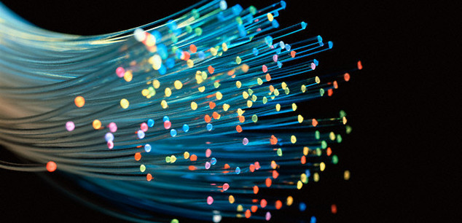
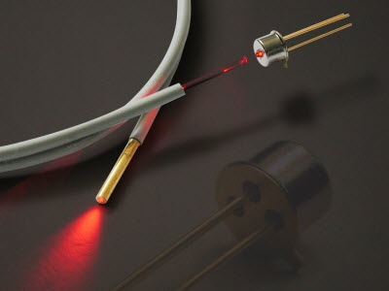
Fibre Optic Cable
Wavelengths of light used for signal carriers
may be a number of colours - WDM
Light is laser LED;
laser light is a single frequency
... (i.e. a single wavelength)
Reflections: Internal reflection of the glass fibre
Signal degrades due to impurities in the glass
Light Signal
Fibre

Slide 27
Fibre Optic Cable
Transparent glass or plastic fibres
allow light to be guided from one end to the other with minimal loss
Electrical to Light Conversion
(O/E)
Light to Electrical Conversion
(O/E)

Slide 28
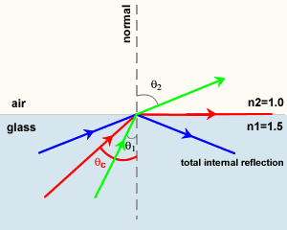
Fibre Optic Cable
Total Internal Reflection
Light passing from one medium (m₁) to another (m₂) with lower index of refraction (ri) bends away from the normal line
At the critical angle, defined by sin ( θ ) = n₁ . n₂, the refracted light will not go into the second medium but will travel along the border

Slide 29
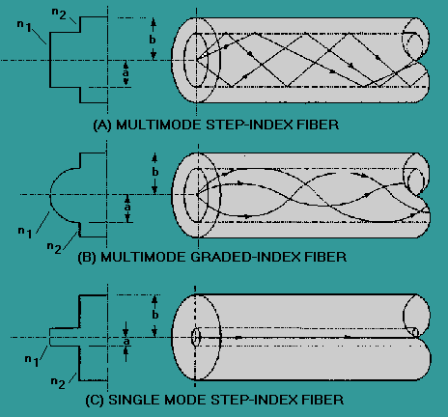
Fibre Optic Cable
Three types of fibre optic cable commonly used:
Multimode - MMF
many rays (modes)
core = 62.5 microns
(some 50 microns)
LED and laser sources 850, 1300nm
LANs
graded index ~2GHz b/w
step index is rare
Single mode - SMF
single ray (mode)
core = 9 microns
telephony, CATV
laser @ 1300, 1550 nm
b/w ~ 100THz

Slide 30
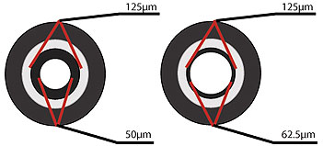
Fibre Optical Multimode, Indexes
Step-Index Multimode Fiber
large core
some rays direct - others zigzag
arrive separately ∴ pulse spreads out
leave space … prevent overlapping
limits data rate
for short(er) distances, <2km, LANs, SANs,
data centers etc
Graded-Index Multimode Fiber
refractive index reduces from the centre
centre: higher index
rays travel more slowly than those further out
rays curve helically
edge rays – zig-zag
edge rays and central rays travel (more) equal distances
∴ pulse suffers less dispersion
Typically use LEDs as source 850-1310 nm
lower cost
higher loss
higher loss

Slide 31
Fibre Optics - Singlemode
small diameter core: 9μm
allows only one mode of light to propagate
number of light reflections created as the light passes through the core decreases
lowers attenuation
signal can travel further
high precision packaging
typically used in long distance >60km; WAN, MAN
higher bandwidth runs by Telcos, CATV companies
Typically use lasers as source

Slide 32
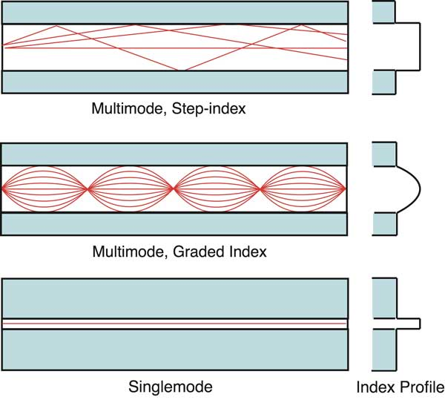
Fibre Optics
Most fibres 125um outside diameter
MMF
larger core: 50 or 62.5um
wavelengths: 850 and 1300 nm
SMF
smaller core ~9um
Plastic Optical Fibre (POF)
large core ~1mm
usually step index
short, low speed
PCS, HCS
PCS plastic clad silica
HCS hard clad silica
smaller glass core ~200um
thin plastic cladding
Summary of Modes and dispersion

Slide 33
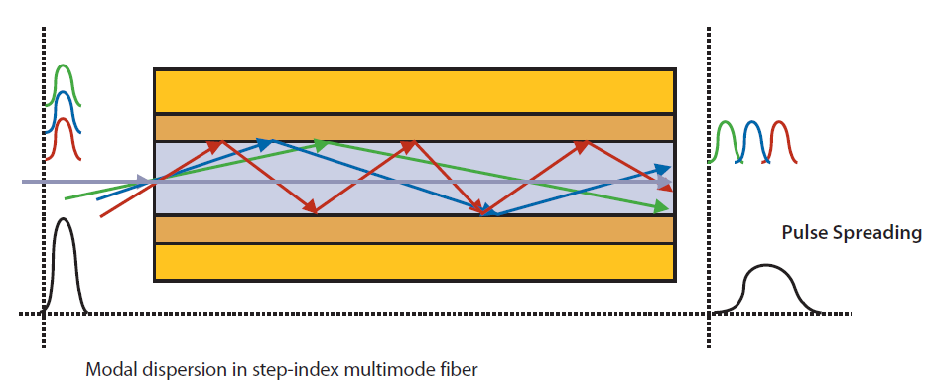
Fibre Optics – Chromatic Dispersion

Slide 34
CATV Fibre Optics
CATV
Most CATV applications
both single mode and multimode signals
within different areas of the network:
Headend –to- fibre nodes: Single Mode fibre
then converted to multimode for remaining outward distribution

Slide 35
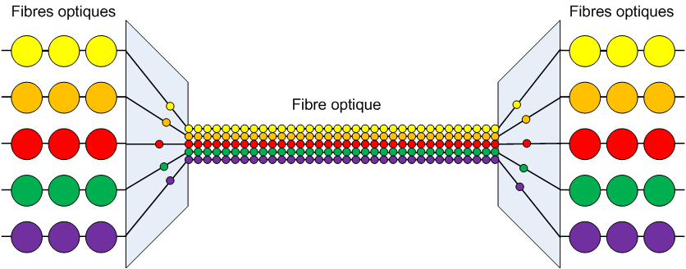
WDM – Wave Division Multiplexing
A number of multiplexes (each of many channels) are carried on one fibre
Each multiplex is a string of data, each on its own wavelength
Uses single mode fibre
Sources
Receivers
Fibre Optic

Slide 36
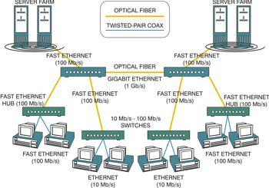
Fibre Networks

Slide 37
Dark Fibre
network infrastructure - mixture of cabling, switches and repeaters
no data = no light: ‘dark’ .. not in use
Originally - When Networks Planned / Built:
usually overestimate cabling required, so many fibres dark, for future expansion
Plus, now - Dark Fibre often leased from network providers and operators
client create / operate their own privately-operated optical fibre network
.. rather than just leasing bandwidth
Could be dark fibre rings, point to point or point-to-multipoint configurations
clients aim for high performance, a high security, superfast
better signal strength
more immune to interference than fibre on traditional networks
DWDM (Dense Wavelength Division Multiplexing)
key in the development of Dark Fibre
multiple data signals are transmitted simultaneously, different wavelengths
higher capacity

Slide 38
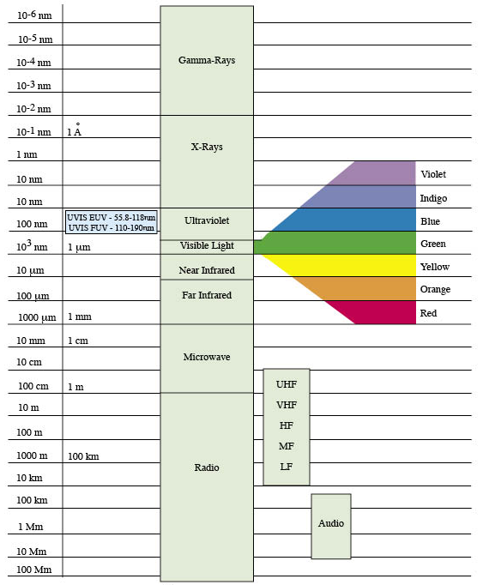
Electromagnetic
Spectrum;
Radio – LF to VHF
nm=nanometres
= 10⁻⁹ meters
Angstrom Unit =
= 10⁻⁸ meters
HF and VF Bands:
Tend to be absorbed by the Earth
Can be bounced off of the ionosphere (called sky wave propogation)
VLF, LF and MF Bands:
Range of about 1000km
Penetrate buildings
Omnidirectional
higher freqs = shorter wavelength
μm=micrometres
= 10⁻⁶ meters
(a millionth)
Audio wavelengths (not EM) – shown for comparison

Slide 39
Radio - Microwave
nm=nanometres
= 10⁻⁹ meters
Properties:
Travel in a nearly straight line
Can be narrowly focused (by a parabolic antenna)
High signal to noise ratio
Little interference
Low penetration
Do not pass through buildings
At 4GHz and above, the waves are very short and can be absorbed by water (e.g., rain)
At 60GHz the waves can be absorbed by oxygen
Range:
2GHz-6GHz: 70km
18GHz-45GHz: 1.6-8km
Angstrom Unit =
= 10⁻⁸ meters
μm=micrometres
= 10⁻⁶ meters
(a millionth)
Audio wavelengths (not EM) – shown for comparison

Slide 40
Radio and TV Frequency Band Allocations
BAND Freqs, MHz Typical usage
LW 0.14 - 0.28 BBC Radio 4 LW (0.198MHz)
MW 0.58 - 1.6 Medium Wave Radio Stations
HF 3 - 26 special broadcast services, popular for Pirate radio
CB 26 - 28 CB
Low VHF 29.7 - 47 Military, Model aircraft, hospital
Band I 47 - 68 old TN band; now alarms, cordless phones, car alarms
Low Band 68 - 87.5 Military, emergency services, private business radio
FM, Band II 87.5 - 108 FM radio broadcast
Air Band 108 - 137 Aero comms, navigation
Mid Band 137 - 165 Military, police
Marine Band 156 - 163 Marine, ports, navigation, distress
High Band 165 - 174 Medical, telemetry, theatres
Band III 174 - 230 special applications, eg via JFMG freq allocation
NATO Band 230 - 400 NATO, space shuttle
UHF1 & 2 400 - 470 Navigation, repeaters, telemetry
TV, Bands IV & V 470 - 854 TV broadcasting, PAL, SECAM
GSM & mobile 854 - 960 GSM mobile, aero, navigation, astronomy
Amateur 23cm 1.2GHz Amateur use
Microwaves 1 - 300GHz Communications links
Ku TV Band 10.7-12.75GHz Comms, satellite support
Visible Spectrum

Slide 41
TV/Radio Broadcast Transmitter
electromagnetic energy from output signal is propagated from the antenna
may be unidirectional, or focussed in particular direction by antenna design
ANTENNA
sound
MODLATOR
OUTPUT POWER STAGE
video
CARRIER
Output stage
small transmitters – may be solid state
large transmitters – valves more efficient

Slide 42
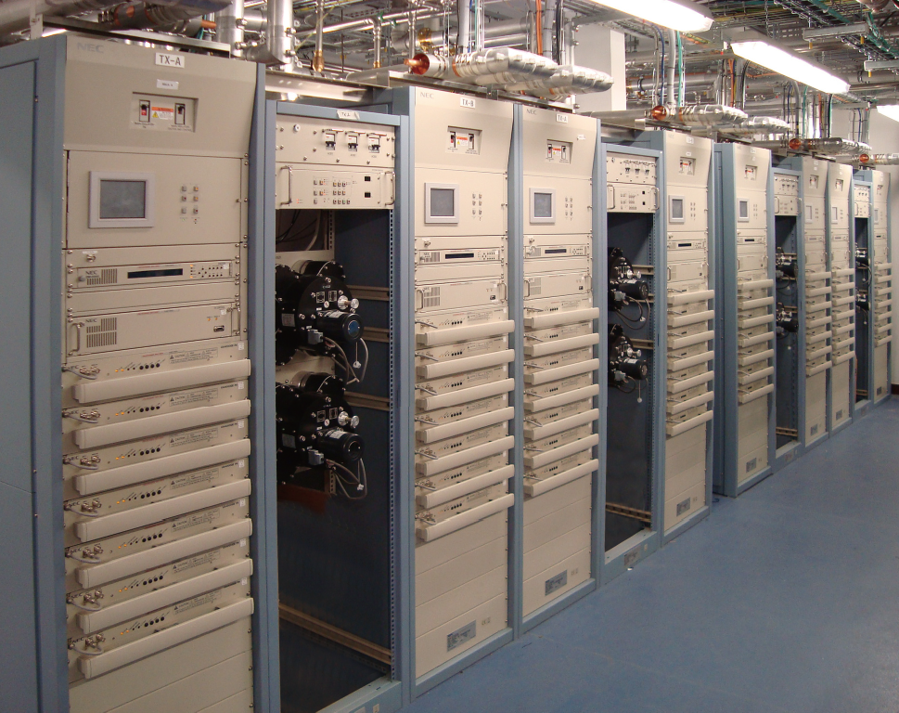
NEC DTU-52 Transmitter equipment, Winter Hill, UK, for Arquiva, transmission provider for UK terrestrial TV

Slide 43
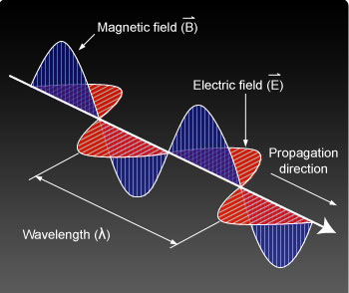
Electromagnetic Wave
alternating electrical current produces an electric and magnetic field that are also alternating
the wave of the electric field and the wave of the magnetic field are propagated perpendicularly to the direction of propagation and to each other
(left) http://learn.uci.edu/oo/getOCWPage.php?course=OC0811004&lesson=005&topic=002&page=21

Slide 44
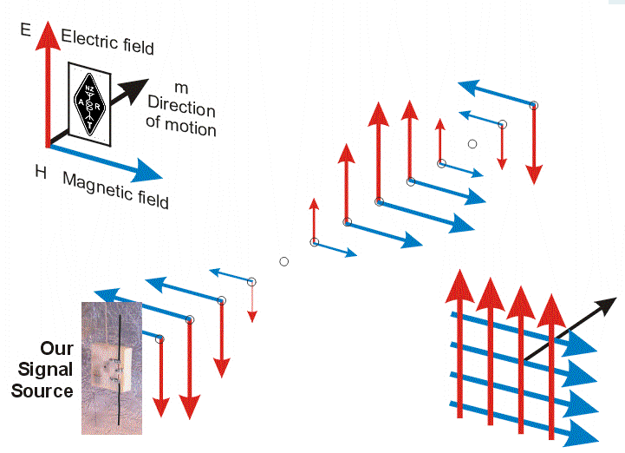
Electromagnetic Wave

Slide 45
Radio Waves - Basic Antenna
Transmitter - generates radio-frequency energy
energy travels through a transmission line to an antenna
antenna converts the energy into radio waves
radio waves radiate into space from the antenna at the speed of light
radio waves travel through the atmosphere or space until they are either reflected by an object or absorbed
Receiving antenna
in the path of the radio waves
absorbs part of the waves and converts them to energy
energy travels through transmission line
fed to a receiver
Transmitter
Antenna
Receiver
Antenna
Transmitter Station
Receiver Station
Transmission line
Transmission line

Slide 46

Basic Antenna
Wet foliage can cause problems in reception
… especially for higher frequencies
Transmitter
Antenna
Receiver
Antenna in “shadow” of tree (especially when wet)
Transmitter Station
Receiver Station
Transmission line
Transmission line

Slide 47
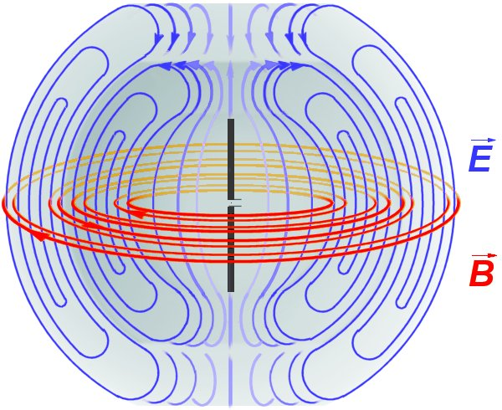
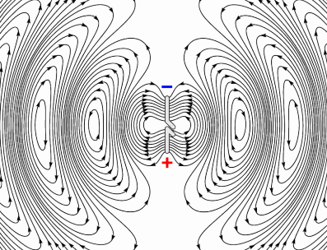
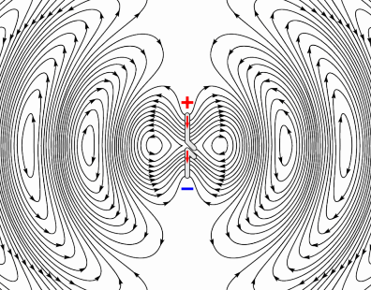
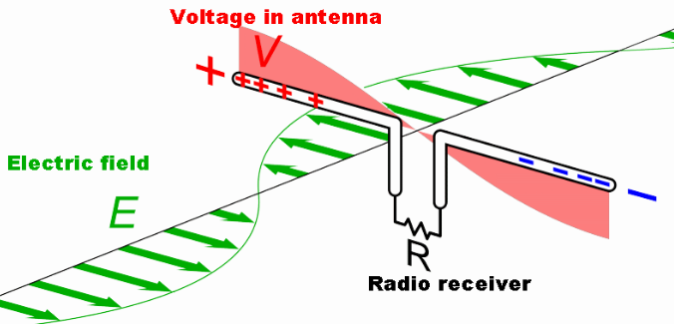
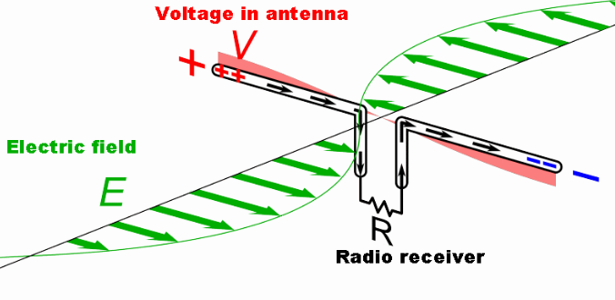
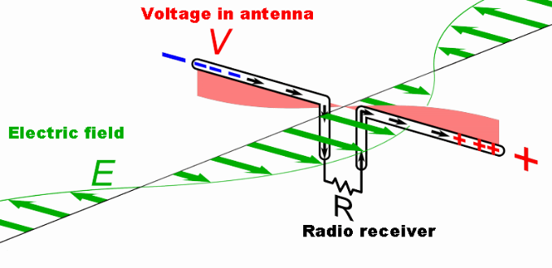
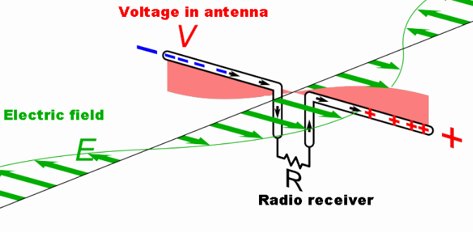
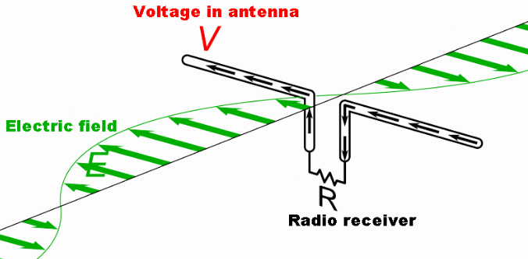
Radio Transmission and Reception
Electric and magnetic fields generated by a dipole antenna
Radiating electrical field from transmitter
Induced electric and magnetic fields in receiver
Note charge and current directions

Slide 48
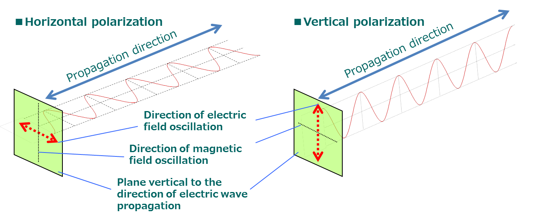
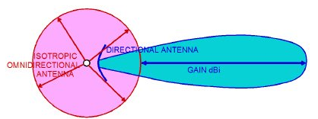
Radio Transmission and Reception
Antenna / transmission polarisation
Antenna Power Gain
combination of directivity and electrical efficiency
Transmitting antenna - how well the antenna converts input power into radio waves headed in a specified direction
Receiving antenna - how well the antenna converts radio waves arriving from a specified direction into electrical power

Slide 49
Radio Wave Propagation
For reception, antenna length at least λ/4
Low freq (e.g. AM services)
earth ground has strong influence
induce current in ground
attenuated by absorbtion in earth
attenuation increases with increase in freq
maximum range depends on …
transmitted power, frequency (< few MHz)
Higher Frequencies – VHF, UHF
Waves can be refracted off Troposphere
(lowest of atmospheric layers)
refraction due to atmospheric rerfractive indeces
(so not a guaranteed performance due to changing weather)
… see later …
Surface Waves

Slide 50
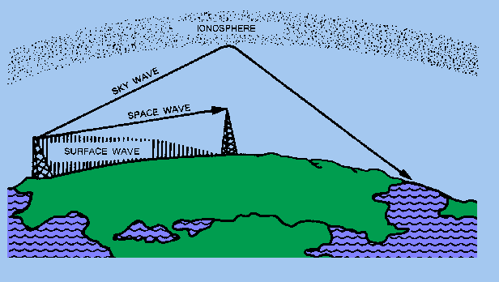
Radio Wave Propagation
Ground waves
propagate along the earth surface, close to the ground
(never reach the ionosphere)
typically travel 150Km in daytime
higher freqs are subject to a high attenuation
… travel less than 15 km (at 30 MHz)
mainly for low frequencies below 1.8 MHz (MW, LW and VLF)
Space waves / Line of Sight
directly from antenna to another without reflection on the ground
also assisted by waves bending near the ground (curved path on earth surface)
Sky wave propagation:
next slide ...

Slide 51
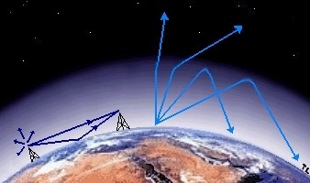
Radio Wave Propagation
Troposphere
where all weather takes place; rising and falling packets of air
air pressure at the top of the troposphere is only 10% of that at sea level (0.1 atmospheres)
Stratosphere
air flow is mostly horizontal
thin ozone layer in the upper stratosphere
high concentration of ozone
warm: absorbs UV radiation from the Sun
Ionosphere
(generally) ionized by solar radiation (∴ aurora)
Ionosphere
~85km – 1000km
Mesosphere
Stratosphere
~45km – 85km
~12km – 45km
Troposphere
to ~12km

Slide 52

Radio Wave Propagation
Refraction
bending of waves passing through different media (air or ionosphere)
produces variation in the velocity of waves
Ionospheric scatter
Ionosphere – ~80Km – 600Km+ above the earth
Ionosphere layers
signals can “bounce” off the ionosphere and reach further round the earth
Transmitter antennae
increasing
frequency

Slide 53

Radio Wave Propagation - Localised Issues
Diffraction
location is out of sight of transmitter (e.g. - behind a hill)
can receive transmissions (but reduced)
(although HF will more likely reach due to refraction or reflection in the upper atmosphere)

Slide 54

Radio Wave Propagation
Reflection
similar to light
for long wavelengths (80m+)
small obstacles (cars, trees) have little effect
objects small compared to the wavelength, can't reflect the energy
long waves are reflected by the ground ... but also penetrate
short wavelengths - V/UHF waves (2m - 70cm)
very sensitive to small obstacles
metal objects can be used as reflectors
Reflections
e.g. wi-fi in metal framed buildings
radio waves reflect and interact
could cause stronger or weaker reception

Slide 55


Broadcast Output Power Stages
Years ago - tetrode and pentode valves mainly used on V.H.F. and U.H.F.
Over years, broadcast on higher frequencies - dimensions of the electrodes decreased in order to reduce their effect on the tuned circuits
∴ reduction in power
Magnetron developed,
then klystron
Now – more efficient Inductive Output Tubes (IOT) or Klystrdes (right)
capable of producing power output up to about 30 kW continuous and 7 MW pulsed and gains of 20 - 23 dB at frequencies up to about a GHz
http://www.theonlineengineer.org/TheOLEBLOG/radio-waves-a-tutorial/
http://www.thevalvepage.com/valvetek/uhfvalve/uhfvalve.htm
http://www.lbl.gov/MicroWorlds/ALSTool/ALS_Components/RFSystem/
http://steveblank.com/category/secret-history-of-silicon-valley/page/2/
http://www.theonlineengineer.org/TheOLEBLOG/how-iots-work-a-tutorial-2/
http://www.youtube.com/watch?feature=player_embedded&v=ecxKfZ3ATwg

Slide 56



Broadcast Headend Transmitter
IOTs – High power devices
Need special management for cooling
Air Conditioned environment
Water-cooled circuits
Safety features

Slide 57

How IOTs Work
https://www.youtube.com/watch?v=fx0asm1kvRw

Slide 58


Slide 59
The Signal Path

Slide 60


Broadcast and Production Workflow (BBC Schematic)
(review from week 8)
Transmission
Low end /
Domestic
Camcorders /
DSLRs
Edit
PRODUCTION
Effects
Grading
CODING
&
MULTIPLEX
Audio
Dubbing
News
Camcorders
Graphics
SCHEDULE
CREATION
Hi-End
Camcorders
Data
Input
AUTOMATION
& PLAYOUT
EPG
CREATION
Digital
Cinema
Cameras +
Recorders
ACQUISITION
LOGGING
INGEST
MEDIA
STORE
DELIVERY
Multi-
Camera
Studio / OB
Data Store
Database
Streaming
Encoding
Live Feeds
Studios
OBs
Other
Material
iPlayer
Website
Data
Input
CDN
INTERNET
ARCHIVE
Media
Metadata
Both

Slide 61

Contribution and Distribution
Production Contribution Distribution Consumption

Slide 62




Media Distribution
Video Head-End
VOD and
Various
Functions
(Servers, etc)
Distribution Network
Satellite
Cable
Telco Broadband
Terrestrial TV
Web (OTT)
Mobile
End Users
Access to
WWW
Telephone N/W
Ingest of Media
STB, etc
Network Access Equipment

Slide 63

Media Distribution ... ... Satellite
Video Head-End
VOD and
Various
Functions
(Servers, etc)
End Users
Access to
WWW
Telephone N/W
Ingest of Media
STB, etc
Network Access Equipment

Slide 64

Media Distribution - Digital Terrestrial (DTTV)
Video Head-End
VOD and
Various
Functions
(Servers, etc)
End Users
Access to
WWW
Telephone N/W
Ingest of Media
STB, etc

Slide 65
Media Distribution – Cable
Video Head-End
VOD and
Various
Functions
(Servers, etc)
Cable Network
Network Managed and Operated by Network Provider / Operator
- Routing, Switching, etc
End Users
Access Network
Access to
WWW
Telephone N/W
Ingest of Media
STB, etc
Network Access Equipment

Slide 66
Media Distribution – IPTV - Telco Broadband, OTT/Web
Video Head-End
Telco Broadband
VOD and
Various
Functions
(Servers, etc)
Network Core
Network Managed and Operated by Network Provider / Operator
- Routing, Switching, etc
End Users
Access Network
Access to
WWW
Telephone N/W
Ingest of Media
STB, etc
Network Access Equipment

Slide 67
Media Distribution – IPTV - Telco Broadband, OTT/Web
Video Head-End
Telco Broadband
VOD and
Various
Functions
(Servers, etc)
OTT
Network Core
Network Managed and Operated by Network Provider / Operator
- Routing, Switching, etc
End Users
Access Network
Access to
WWW
Telephone N/W
Ingest of Media
OTT
STB, etc
WEB-BASED VIDEO PROVIDER
Network Access Equipment

Slide 68


